Slide 1


Processing in
Memory: The Terasys
Massively Parallel
PlM Array
孙旻聿 S211000805

Slide 2

CONTENTS
目录
INTRODUCTION
TERASYS WORKSTATION
01
02
DATA-PARALLEL BIT C
APPLICATIONS AND PERFORMANCE
03
04

Slide 3

01
INTRODUCTION

Slide 4
introduction
SIMD processor arrays provide superior performance on fine-grained massively parallel problems in which all parallel threads do the same operations most of the time.
However, this fine-grained synchrony limits the application space of SIMD (single instruction, multiple data) machines.
If there are many alternative data- dependent actions among the parallel threads, the total execution time is the sum of the alternatives rather than the maximum single-thread execution time.
Additionally, if the application is not inherently load-balanced, performance can degrade seriously: Most of the processors finish their work quickly and become idle, while a few processors end up with the lion’s share of the work.
Thus, the economics of purchasing a high-performance computer often dictate giving up peak performance on a small application set (massively parallel SIMD) in favor of more modest improvement over a larger range of applications (general-purpose MIMD).
Notes:
SIMD处理器阵列在细粒度大规模并行问题上提供了优越的性能，在这些问题中，所有并行线程大部分时间都执行相同的操作。然而，这种细粒度的同步限制了SIMD（单指令多数据）机器的应用空间。如果并行线程之间存在许多与数据相关的可选操作，则总执行时间是可选操作的总和，而不是最大单线程执行时间。此外，如果应用程序本身不是负载平衡的，那么性能可能会严重降低：大多数处理器很快完成工作并变得空闲，而少数处理器最终承担了大部分工作。因此，购买高性能计算机的经济性通常要求放弃小型应用程序集（大规模并行SIMD）的峰值性能，转而在更大范围的应用程序（通用MIMD）上进行最现代化的改进。

Slide 5
introduction
In this paper: We have integrated the SIMD array so closely into the architecture of the high- performance host that the hardware comprising the SIMD array can be used either as a SIMD processor array or as additional conventional memory.
SRC researchers have designed and fabricated a processor-in-memory (PIM) chip, a standard 4-bit memory augmented with a single-bit ALU controlling each column of memory. In principle, PIM chips can replace the memory of any processor, including a supercomputer.
To validate the notion of integrating SIMD computing into conventional processors on a more modest scale, we have built a half dozen Terasys workstations, which are Sun Microsystems’ Sparcstation-2 workstations in which 8 megabytes of address space consist of PIM memory holding 32K single-bit MUS.
Notes:
1.在本文中：已将SIMD阵列紧密集成到高性能主机的体系结构中，因此构成SIMD阵列的硬件既可以用作SIMD处理器阵列，也可以用作额外的常规内存。
2.SRC研究人员设计并制造了一种内存处理器（PIM）芯片，一种标准的4位内存，由一个控制每列内存的单位ALU扩充。原则上，PIM芯片可以取代任何处理器的内存，包括超级计算机。为了验证以更适度的规模将SIMD计算集成到传统处理器中的概念，我们构建了六台Terasys工作站，这是Sun Microsystems的Sparcstation-2工作站，其中8兆字节的地址空间由容纳32K位MU的PIM内存组成。我们为Terasys设计并实现了一种高级并行语言，称为数据并行位C（dbC），并演示了使用PIM内存作为SIMD阵列的dbC应用程序以多个Cray-YMP处理器的速度运行。因此，我们可以用超级计算机成本的一小部分来提供超级计算机的性能。

Slide 6
02
TERASYS WORKSTATION

Slide 7
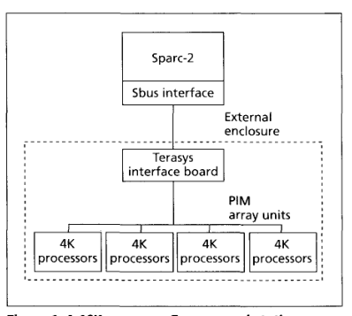
TERASYS WORKSTATION
A Terasys workstation consists of ：
a Sun Sparc-2 processor,
an SBus interface card residing in the Sparc cabinet,
a Terasys interface board, and
one or more PIM array units.
Notes:
Sun Sparc-2处理器
Sparc机柜中的SBus接口卡
Terasys接口板
一个或多个PIM阵列单元。

Slide 8
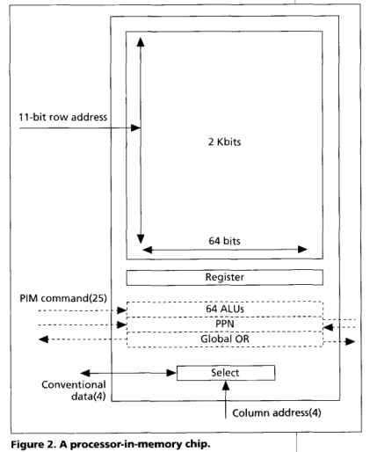
Processor-in-memory chip
The PIM integrated circuit, with slightly over one million transistors on 1-micron technology, contains 2K x 64 bits of SRAM, 64 custom-designed single-bit processors, plus control and error detection circuitry.* Figure 2 shows the PIM chip. Solid lines outline conventional memory components, while dotted lines delimit the added PIM circuitry.
Notes:
PIM集成电路采用1微米技术，晶体管略多于100万个，包含2K x 64位SRAM、64个定制设计的单位处理器以及控制和错误检测电路。*图2显示了PIM芯片。实线勾勒出传统内存组件，虚线勾勒出添加的PIM电路。

Slide 9
Processor-in-memory chip
In conventional memory mode, the chip is configured as a 32K x 4-bit SRAM with an 11-bit row address and a 4-bit column address. In response to the row address signals, it loads the selected row into a 64-bit register. The column address selects a 4-bit nibble (one of 16 nibbles composing the 64-bit register).
To operate in PIM mode, the chip is activated by one of 25 command bits from the Terasys interface board. Command mode initiates an internal row operation with 64 processors operating on one of 2K rows of memory. The processors can perform a local operation and optionally read/write the global OR, partitioned OR, and parallel prefix lines.
Notes:
在传统存储器模式下，芯片配置为32Kx 4位SRAM，具有11位行地址和4位列地址。作为对行地址信号的响应，它将所选行加载到64位寄存器中。列地址选择一个4位半字节（构成64位寄存器的16个半字节之一）。为了在PIM模式下工作，芯片由Terasys接口板的25个命令位之一激活。命令模式启动一个内部行操作，64个处理器在其中一行内存上运行。处理器可以执行本地操作，并可选地读/写全局或、分区或和并行前缀行。

Slide 10
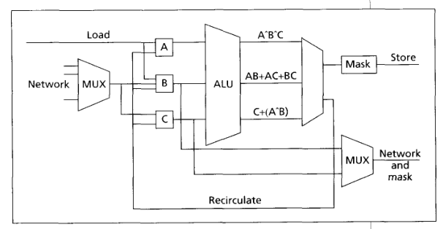
PIM processor
The PIM processor is a bit-serial processor that accesses and processes bits to/from a 2-Kbit column of attached memory. Functionally, the processor is divided into upper and lower halves. The upper half performs the actual computations on the data, while the lower half performs routing and masking operations. Data is brought in from the processors’ attached memory through the load line, circulates through the logic as specified by the program, and is written back to memory via the store line.
Notes:
PIM处理器是一个位串行处理器，它访问和处理连接内存的2-Kbit列中的位。从功能上讲，处理器分为上半部分和下半部分。上半部分对数据执行实际计算，而下半部分执行路由和屏蔽操作。数据通过加载线从处理器连接的内存中引入，通过程序指定的逻辑进行循环，并通过存储线写入内存。三个主寄存器（表示为A、B和C）向ALU提供数据。寄存器有三条主要输入线用于接收数据，每条输入线也可以反转以接收该输入的逻辑NOT。在每个时钟周期，流水线ALU既可以从内存加载数据，也可以将数据存储到内存，但不能同时加载数据和存储数据。此外，在每个时钟周期，MU产生三个输出，可以选择存储（在掩码控制下）或选择再循环。此外，数据可以通过路由网络发送到其他处理器。处理器可以通过多路复用器（MUX）从并行前缀网络、全局或网络、分区或网络或内部MasureRegister控件输入数据。

Slide 11
Indirect addressing
First , introducing indirect addressing registers on a per-processor basis would reduce the number of processors per chip.
Second, the error detection and correction circuitry, which operates on a row basis, would not operate correctly in the presence of per-processor indirect addressing registers
Notes:
由于两个主要原因，我们决定在当前PIM实现中不支持间接寻址indirect addressing的硬件支持。首先，在每个处理器的基础上引入间接寻址寄存器将减少每个芯片的处理器数量。其次，以行为基础运行的错误检测和校正电路在每个处理器的间接寻址寄存器存在的情况下无法正确运行。因此，我们选择通过微码进行间接寻址。为了提高此操作的效率，我们让编译器在索引操作中发出数组绑定信息。这允许微代码索引子例程将要查询的位置数限制为数组元素数，而不是整个2K位。
八个PIM内存E组中的每一个包含八个PIM芯片——每个阵列单元总共64个芯片或4096个PIM处理器

Slide 12
lnterprocessor communication
GLOBAL OR：The logical OR network combines signals from all processors and returns a single bit result to the host. GOR Is performed across all 32K processors in hardware.
PARALLEL PREFIX NETWORK (PPN)：The PPN consists of 15 levels, settable by the programmer. It can be used for nearest-neighbor communication and for linear scan operations, which are useful for accumulating partial results such as sums or other associative operations.
GENERAL DATA MOVEMENT：For general any-to-any communication, PIM data values are sent to the host, transposed from bit-serial to bit-parallel representation, permuted in conventional memory, transposed again, and sent back to the PIM memory.
Notes:
1.逻辑或网络组合来自所有处理器的信号，并向主机返回一个位结果。GOR在硬件中的所有32K处理器上执行。
2. PPN由15个级别组成，可由程序员设置。它可用于最近邻通信和线性扫描操作，用于累积部分结果，如总和或其他关联操作。
3.对于一般的任意对任意通信，PIM数据值被发送到主机，从位串行转换到位并行表示，在常规存储器中进行置换，再次进行置换，然后发送回PIM存储器。

Slide 13
03
DATA-PARALLEL BIT C

Slide 14
DATA-PARALLEL BIT C
The Terasys programming language dbC is an ANSI C superset based on a tightly synchronous (variously called data parallel, “single thread of control,” or SIMD) parallel programming model. In dbC, arbitrary-length bit streams are treated as first-class objects in the parallel domain . Our goals in designing dbC were to support .
a simple, easy-to-use programming model so that programmers can rapidly become productive on Terasys and other PIM-based systems;
efficient data-parallel computation on SIMD machines;
computation on arbitrary bit-length integers in the parallel domain.
Notes:
Terasys编程语言dbC是基于紧密同步（各种称为数据并行、“单线程控制”或SIMD）并行编程模型的ANSI C超集。在dbC中，任意长度的比特流被视为并行域中的一级对象
1.一个简单易用的编程模型，使编程人员能够在Terasys和其他基于PIM的系统上快速高效地工作；
2.SIMD机器上高效的数据并行计算；
3.和并行域中任意位长整数的计算。

Slide 15
Data-parallel extensions
PARALLEL DATA. dbC adds a new memory attribute to C data declarations, the keyword “poly.” A poly variable is instantiated on each processor, so that a reference to a poly variable in an expression is an aggregate reference that affects each active processor. dbC supports all the standard C data types in the parallel domain. It also supports parallel pointers. Pointers can point between serial and parallel domains and within the parallel domain, pro- viding language support for indirect addressing. Pointers may not point from the memory of one processor to the memory of another; interprocessor communication intrinsics must be called to access data from another processor.
PARALLEL EXPRESSIONS. Polys can be used in C expressions just as normal C (mono) variables. An expression a op b is parallel if either a or b is parallel. If the other operand is serial, it is promoted to parallel, and the operation is performed in the parallel domain.
PARALLEL CONTROL CONSTRUCTS. dbC extends the standard C guarded control constructs (if, while, do, and for) to the parallel domain. The <guard> controlling the statement determines whether the statement is serial or parallel. If the <guard> is parallel, the statement is par- allel. The escape statements break, continue, and return have parallel versions. A break or continue in a parallel loop is parallel. A return from a function returning a parallel result (even poly void) has parallel semantics. Gotos are not allowed in parallel constructs.
Notes:
并行数据。dbC为C数据声明添加了一个新的内存属性，即关键字“poly”。每个处理器上都实例化了一个poly变量，因此表达式中对poly变量的引用是影响每个活动处理器的聚合引用。dbC支持并行域中的所有标准C数据类型。它还支持并行指针。指针可以指向串行域和并行域之间以及并行域内，为间接寻址提供语言支持。指针不能从一个处理器的内存指向另一个处理器的内存；必须调用处理器间通信intrin-sics以从另一个处理器访问数据。
平行表达式。poly可以像普通的C（mono）变量一样在C表达式中使用。如果a或b是平行的，则表达式a和b是平行的。如果另一个操作数是串行的，则将其提升为并行，并在并行域中执行thc操作。
并行控制结构。dbC将标准的C保护控制结构（if、while、do和for）扩展到并行域。控制语句的确定语句是串行还是并行。如果是并行的，则语句是并行的。escape语句break、continue和return具有并行版本。并行循环中的中断或继续是并行的。从返回并行结果（甚至是poly void）的函数返回具有并行语义。在并行构造中不允许GOTO。

Slide 16
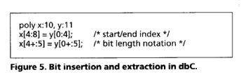
Bit extensions
BIT-LENGTH SPECIFIERS: dbC extends C’s bit-field feature to allow any parallel integer variable (or integer com- ponent of a structured variable) to specify a length. Although the syntax of the bit-length specifier is identical to the C bit field, the semantics are quite different. The C bit field represents a compromise between the desire to access bits and the difficulty of supporting efficient bit access in the word-oriented domain. A bit field declared to be 6 bits long in C might really occupy a full memory word (32 or 64 bits). Averiable or structure component declared as “poly int:6” in dbC is guaranteed to use exactly 6 bits of parallel memory.
BIT EXTRACTION AND INSERTION. dbC also has two bit-oriented operators, bit insertion and bit extraction.
Notes:
位长度说明符。dbC扩展了C的位域特性，允许任何并行整数变量（或结构化变量的整数组件）指定长度。尽管位长度说明符的语法与C位字段相同，但语义却大不相同。C位字段表示访问位的愿望和在面向字的域中支持有效位访问的困难之间的折衷。在C语言中，一个声明为6位长的位字段实际上可能会占用一个完整的内存字（32或64位）。dbC中声明为“poly int:6”的变量或结构组件保证只使用6位并行内存。
并行变量x可以被索引为x[A:b]，其中A表示起始位位置，b表示结束位位置，包括在内。在赋值的右侧-1，该符号表示从位偏移量a开始从x提取b-a+1位。当此“切片”符号用于索引左侧的变量时，将执行位插入。简而言之，x[a:l相当于x[a:a]，表示访问偏移量a处的一位。图中还说明了另一种表示法。索引表达式a+：b中的+：中缀运算符表示起始索引为a，位长度为b

Slide 17
Bit extensions
GENERIC BIT LENGTHS. To make it easier to write sub- routines that can operate on parameters of any bit length, dbC provides a generic bit-length construct. The bit length of a parameter to a function may be ‘I?,” indicating that the length is to be determined at runtime at each invocation of the function. Figure 6 illustrates the use of generic bit length in the parameter x to function func. The function is called twice, first with a parameter of bit length 5, and the second time with a parameter of bit length 7.BIT EXTRACTION AND INSERTION.
COMMUNICATION. The interprocessor communication intrinsic DBC-net-scnd transfers data between nearest neighbors in a linear topology at level 0 in the parallel pre- fix network. In addition, the DBC-send intrinsic can be used for any-to-any communication; this gencral data movement between processors is done through the Sparc conventional memory.
Notes:
通用位长度。为了更容易编写可以对任何位长度的参数进行操作的子例程，dbC提供了一个通用的位长度构造。函数参数的位长度可以是“I”，表示该长度将在函数每次调用的运行时确定。图6说明了在参数x to函数func中使用通用位长度。函数被调用两次，第一次使用位长度为5的参数，第二次使用位长度为7的参数。
表达处理器间通信固有的DBC net scnd在并行预修复网络的0级线性拓扑中的最近邻之间传输数据。此外，DBC发送内部可用于任何对任何通信；处理器之间的gencral数据移动是通过Sparc常规内存完成的。

Slide 18
04
APPLICATIONS AND PERFORMANCE

Slide 19
Bit extensions
The Terasys workstation-fully populated with 32K processors and assuming an instruction issue rate of 100 ns-delivers 3.2 x peak bit operations per second. Microcoded applications have achieved and, in one case, surpassed this theoretical peak. (The program surpassing the peak uses superscalar techniques that do two bit operations in one tick by using both the upper and lower parts of the processor.)
Notes:
Terasys工作站完全配备32K处理器，并假设指令发出速率为100 ns，每秒可提供3.2倍的峰值位操作。微代码应用已经实现，并且有一次超过了这一理论峰值。（超过峰值的程序使用超标量技术，通过使用处理器的上部和下部在一个刻度内完成两位操作。）

Slide 20
2021
Thank you!
湖南大学绿色PPT模板

